Slide 1
PEO BES EN Docker Containers Crash Course
2020
Notes:
1

Slide 2
Agenda
Env Prep
What are Containers?
Working w/ Containers
Container Images
Data Volumes
System Information
Networking
Docker Compose
Notes:
2

Slide 3
Env Prep
Don’t want to install anything?
https://labs.play-with-docker.com/
Works from SDC!
You may not be able to (easily?) complete all exercises
You may wish you knew vi (https://kb.iu.edu/d/afdc)
EVERYONE:
Download exercise files (to “guarantee” proper formatting, save time not typing)
https://github.com/ericisw8n/docker
Notes:
https://docs.docker.com/get-started/
3

Slide 4
Env Prep (cont’d)
Look at Linux VM lesson prep for: BIOS, Hyper-V
Powershell (always run as admin)
Check version: $PSVersionTable.PSVersion
Need version 5+
If not, upgrade: https://www.microsoft.com/en-us/download/details.aspx?id=54616
Chocolatey (the Windows pkg mgr)
https://chocolatey.org/install
VSCode
https://code.visualstudio.com/Download
$ choco install vscode.install
Notes:
4

Slide 5
Env Prep (cont’d)
Docker Desktop (“D”) for Win10 Pro (w/ Hyper-V)
https://docs.docker.com/docker-for-windows/install/
https://docs.docker.com/machine/drivers/hyper-v/
$ choco install docker-desktop --execution-timeout=0
Docker for Linux
https://docs.docker.com/engine/install/
Docker for Mac
https://docs.docker.com/docker-for-mac/install/
Notes:
5

Slide 6
Env Prep (cont’d)
Docker Toolbox (“T”) for non-Win10Pro (no Hyper-V)
https://docs.docker.com/toolbox/toolbox_install_windows/
https://chocolatey.org/packages/docker-toolbox
$ choco install docker-toolbox --force -ia /COMPONENTS="kitematic,virtualbox,dockercompose"
Minikube (for Docker Toolbox – non-Win10Pro)
https://kubernetes.io/docs/tasks/tools/install-minikube/
$ choco install minikube
Install cURL using chocolatey
$ choco install curl -y
Notes:
6

Slide 7
Env Prep (cont’d)
Check all (installed) chocolatey packages
$ clist -l
Close terminal window/shell
T – Open Docker Toolbox
D – Open Docker Desktop (double click desktop icon)
Open terminal window/shell (as administrator)
Notes:
7

Slide 8
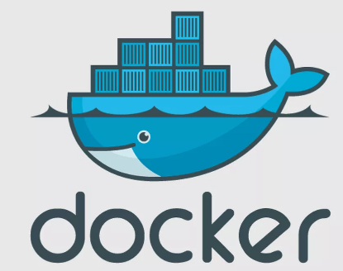
What are Containers?
Old school transport vs Shipping container analogy
Multiple products, moving/mixing freely
Must organize/sort at each port
Must reconfigure transportation method per movement
OR
Pre-organize, into standardized shipping containers
Same methods every time, every location, every transport
Linux vs Windows
Notes:
8

Slide 9
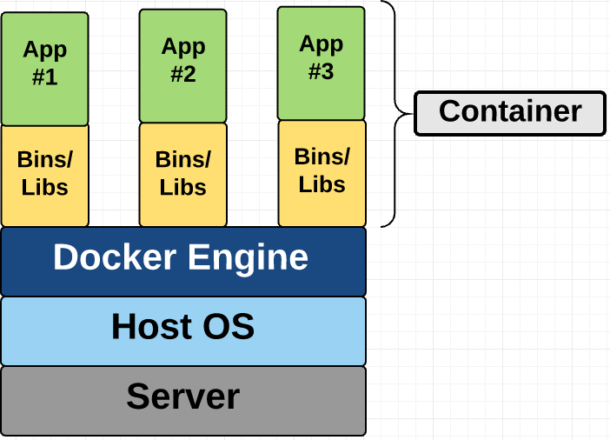
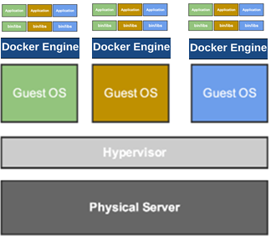
What are Containers (cont’d)
Container
Form of virtualization, runs on top of OS (either Host or Guest OS)
Isolated, but share physical/host resources (kernel)
Secure, very efficient
Encapsulates app & dependencies into single image
DEV or PROD
Notes:
9

Slide 10
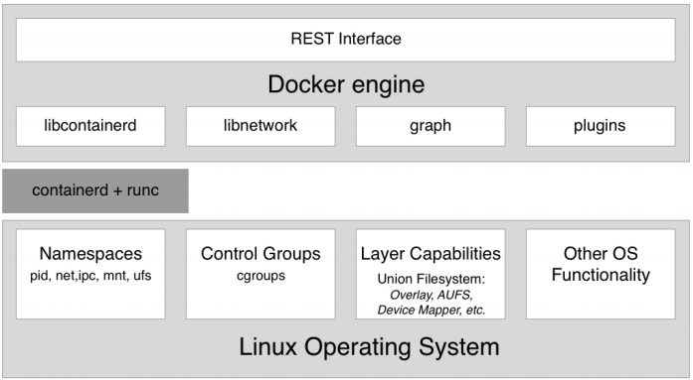
What are Containers? (cont’d)
Typical Docker Host
Notes:
Page 17
Namespaces – process ID (PID) namespaces or network namespaces; allows Docker to encapsulate/”sandbox” processes in container;
Control groups – separate resources/resource use among containers (1 container can’t hog everything)
Containerd + runc = docker container runtime
10

Slide 11
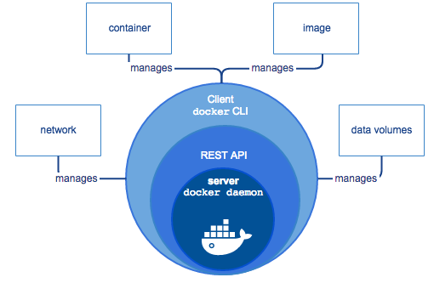
What are Containers? (cont’d)
Docker Engine – “client/server”
Client comms over API to daemon to create/manage network, container, image, volumes, etc.
Notes:
https://docs.docker.com/engine/docker-overview/
11

Slide 12
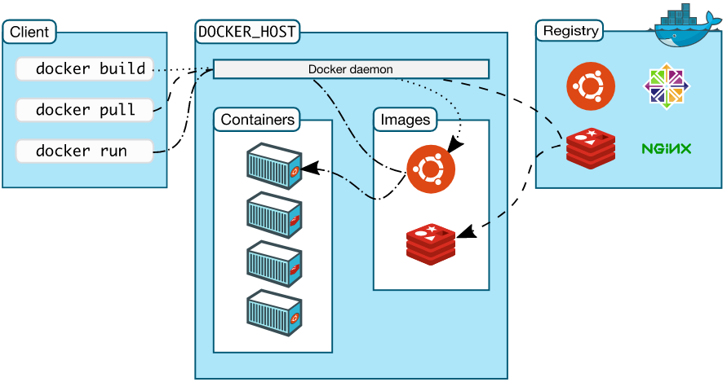
What are Containers? (cont’d)
Docker Architecture
Notes:
12

Slide 13
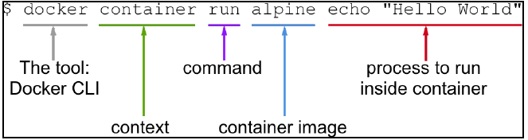
Working with Containers
Run your first container!
May need to create Docker Hub Account, login
D – thru Docker Desktop app?
T – via https://hub.docker.com
Note output
Do it again; note (different) output
Notes:
13

Slide 14
Working with Containers (cont’d)
Your 2nd container.
$ docker container run centos ping -c 5 127.0.0.1
Difference from 1st container?
3rd container. Yawn.
docker container run -d --name nginx -p 8080:80 ‘ nginx:alpine
List “all” containers
docker container ls -a
Remember the “ls” command from Linux?
Notes:
14

Slide 15
Working with Containers (cont’d)
STOP!
docker container stop <container name>
Start
docker container start <container name>
INSPECT
docker container inspect <container name>
Wow, that’s a lot… But what is it?
EXEC into a container (“remote” into the cmd line)
docker container exec -i -t <container name> /bin/sh
i = run process interactively, t = terminal emulator
Notes:
15

Slide 16
Working with Containers (cont’d)
From inside the container shell…
# ps
These are the processes running on the container
# exit
Exits the container shell, back to your host cmd line
Let’s do the same, but different
$ docker container exec nginx ps
Clean up?
REMOVE
docker container rm -f <container name>
Notes:
16

Slide 17
Container Images
Images are used to create containers
Images are made of/in layers
1st layer = base layer
Each layer only contains delta of changes
Each layer is immutable = once create, it can’t be changed
Except top layer = container layer = writable
Images are saved/stored in/retrieved from a registry/repo
Docker Hub = https://cloud.docker.com/
Notes:
17

Slide 18
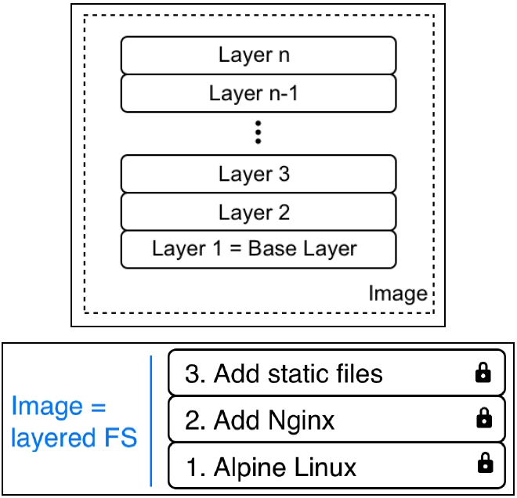
Container Images (cont’d)
Notes:
18

Slide 19
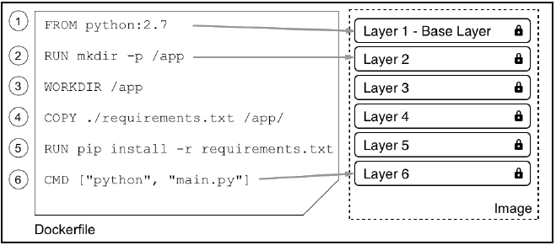
Container Images (cont’d)
Notes:
19

Slide 20
Container Images (cont’d)
Creating an Image
Import
Interactive build
Dockerfile
Interactive build (ugh, so tedious…)
Create base image/layer, login to cmd line
$ docker container run -it --name sample alpine /bin/sh
Inside container, make a change = install ping (etc)
# apk update && apk add iputils
# exit
Check changes made to container
$ docker container ls -a
docker container diff <container name>
Notes:
20

Slide 21
Container Images (cont’d)
Interactive build (cont’d)
A = added
C = changed
Commit/persist changes, create new/final image
docker container commit <original container name> <new image name>
docker image ls
docker image history <new image name>
Notes:
21

Slide 22
Container Images (cont’d)
Dockerfile (now we’re talkin)
Declarative – describe outcome, let system figure it out
Like a SOO
Imperative – step-by-step super specific, only works 1 way
Like a SOW
Dockerfile defines storage, network, software/files, etc.
Each line is a container layer
Notes:
https://docs.docker.com/get-started/part2/
22

Slide 23
Container Images (cont’d)
FROM – defines base image to start with
COPY – copy files from host into container
ADD – similar to copy, but allows use of tar and URLs
WORKDIR – dir to work/start from once container starts
EXPOSE – define network/port
RUN – run cmd inside the container
What happens when container starts:
ENTRYPOINT – define command of the expression
CMD – define parameters of command to run
FROM alpine:latest
ENTRYPOINT [“ping”]
CMD [“8.8.8.8”, “-c”, “3”]
Notes:
https://docs.docker.com/get-started/part2/
23

Slide 24
Container Images (cont’d)
A simple Dockerfile
Create empty directory
mkdir empty1
cd empty1
VSCode
Create Dockerfile (no extension) in empty1 dir
FROM centos:7
RUN yum install -y wget
Build image
$ docker image build -t my-centos .
*** Note the period – it matters!
Notes:
After build, the image exists in your local repo.
24

Slide 25
Container Images (cont’d)
This will be a python app (using Flask framework) with a Redis cache DB, displaying Hello Word, hostname, and (eventually) hit counter
May need to copy/paste to notepad first (get rid of ppt formatting)
Create empty directory
mkdir empty2
Open VSCode
Create Dockerfile (no extension) in empty2 dir (next slide)
Notes:
https://docs.docker.com/get-started/part2/
https://docs.docker.com/compose/gettingstarted/
25

Slide 26
Container Images (cont’d)
Dockerfile:
# Use an official Python runtime as a parent image
FROM python:3.7-slim
# Set the working directory to /app
WORKDIR /app
# Copy the current directory contents into the container at /app
COPY . /app
# Install any needed packages specified in requirements.txt
RUN pip install --trusted-host pypi.python.org -r requirements.txt
# Make port 80 available to the world outside this container
EXPOSE 80
# Define environment variable
ENV NAME World
# Run app.py when the container launches
CMD ["python", "app.py"]
Notes:
If python 2.7 not available, next reliable version is 3.2.
May need to remove and re-place ALL “spaces” in/using VSCode.
Similar, more involved example: https://docs.docker.com/compose/gettingstarted/
26

Slide 27
Container Images (cont’d)
Create: requirements.txt
Flask
Redis
Create: app.py
from flask import Flask
from redis import Redis, RedisError
import os
import socket
# Connect to Redis
redis = Redis(host="redis", db=0, socket_connect_timeout=2, socket_timeout=2)
app = Flask(__name__)
@app.route("/")
def hello():
try:
visits = redis.incr("counter")
except RedisError:
visits = "<i>cannot connect to Redis, counter disabled</i>"
html = "<h3>Hello {name}!</h3>" \
"<b>Hostname:</b> {hostname}<br/>" \
"<b>Visits:</b> {visits}"
return html.format(name=os.getenv("NAME", "world"), hostname=socket.gethostname(), visits=visits)
if __name__ == "__main__":
app.run(host='0.0.0.0', port=80)
Notes:
https://docs.docker.com/get-started/part2/
27

Slide 28
Container Images (cont’d)
Dockerfile (cont’d)
Build Image (from new dir)
docker build --tag=firstimagebuild .
*** Note the period – it matters!
docker image ls
Image is stored in local registry
Run container/app
docker run -p 4000:80 firstimagebuild
Notes:
May have some build errors due to ppt copy/paste into VSCode. Figure it out (notepad?).
Hyper-V host ip = in powershell, ipconfig /all; look for Hyper-V
or
host ip = docker-machine ip default
Also,
Docker image build –tag=firstimagebuild .
OR
Docker image build –t firstimagebuild –f Dockerfile .
f = name of dockerfile
. = current directory
28

Slide 29
Container Images (cont’d)
Find IP of host VM, new terminal window
T - $ docker-machine ip default
D - $ ipconfig /all
Look for “Hyper-V” or
“Ethernet adapter vEthernet (Default Switch):”
Copy/paste to text file
Open web browser
Enter IP of VM/Hyper-V host:4000 (port mapped from container port 80 to host port 4000)
Try curl (did you install it, using chocolatey?)
Notes:
May have some build errors due to ppt copy/paste into VSCode. Figure it out (notepad?).
Hyper-V host ip = in powershell, ipconfig /all; look for Hyper-V
or
host ip = docker-machine ip default
Also,
Docker image build –tag=firstimagebuild .
OR
Docker image build –t firstimagebuild –f Dockerfile .
f = name of dockerfile
. = current directory
29

Slide 30
Container Images (cont’d)
Upload/publish image to Docker Hub (create account, etc.)
From image directory (PS C:\~\emptyX)
Docker Hub is pre-config’d default (official) image registry
Others – Google, AWS, Azure, RedHat, Artifactory
<registry URL>/<user or org>/<image name>:tag
Tag = version; if no tag, then “latest”
hub.docker.com
Create account (username password), then
$ docker login -u <username> -p <password>
Tag image
docker tag <image name> <username>/<repoName>:<tag>
Notes:
https://docs.docker.com/get-started/part2/
30

Slide 31
Container Images (cont’d)
Publish/push image
docker push <username>/<repoName>:<tag>
See cmd line input (success?), check docker hub too
Remove local image(s), container(s)
docker image rm -f <image name>
docker container rm -f <container name>
Pull/run (new, docker hub) image, container
docker run -p 4000:80 <username>/<repo name>:<tag>
docker container ls -a … ?
Open web browser
Enter IP of VM/Hyper-V host:4000 (port mapped from container port 80 to host port 4000)
Try curl
Notes:
Want to remove all? Are you sure?
docker image rm -f $(docker image ls -a -q)
docker container rm -f $(docker container ls -a -q)
31

Slide 32
Data Volumes
Volume: a way to store data outside of the container, so the data persists (beyond the life, or state, of the container)
Create a volume, stored on physical host
*** (may not need to do this: docker-machine)
docker-machine ls ???
docker-machine create -driver virtualbox node-1 ???
docker-machine start node-1 ???
docker-machine ssh node-1
*******************************
docker volume create <volume name>
Inspect/check volume (check for <Linux VM> host path)
docker volume inspect <volume name>
Notes:
32

Slide 33
Data Volumes (cont’d)
Prove volume data persistence:
Run a container, mount volume (/data), log into container
docker container run --name <container name> -it
-v <volume name>:/data alpine /bin/sh
Add some data/files to the container dir (which mounts to volume path on Linux VM host)
# cd /data
# echo “some data” > 1data.txt
# echo “some more data” > 2data.txt
# ls -la
# exit
Notes:
33

Slide 34
Data Volumes (cont’d)
Remove container (to prove volume data persists)
docker container rm -f <container name>
Create, run new/different container w/ same volume
docker container run --name <container2 name>
-it -v <vol name>:/app/data centos:7 /bin/sh
Check for persistent files/data
# cd /app/data
# ls -la
DO NOT EXIT
Notes:
34

Slide 35
Data Volumes (cont’d)
Using (still) running container (read/write) and volume
# pwd
# echo “even more data for sharing” > shared.txt
# ls –la
Share data between containers (cont’d):
Open new terminal window
Create a read only container:
$ docker container run -it --name rocont -v
<volume name>:/app/data:ro busybox:latest /bin/sh
Notes:
35

Slide 36
Data Volumes (cont’d)
Search for shared files & compare containers’ contents
# pwd
# ls -la
Try to write to the read only container volume
# echo “try to write” > readonly.txt
# exit
Notes:
36

Slide 37
Data Volumes (cont’d)
Clean up:
docker container ls -a
docker container stop <container name>
docker container rm -f <container name>
$ docker container rm -f $(docker container ls -aq)
$ docker image rm -f $(docker image ls -aq)
docker volume rm <volume name>
$ docker volume rm -f $(docker volume ls -q)
Notes:
37

Slide 38
System Information
Gathering info
docker version
docker system info
docker system df -v
Notes:
38

Slide 39
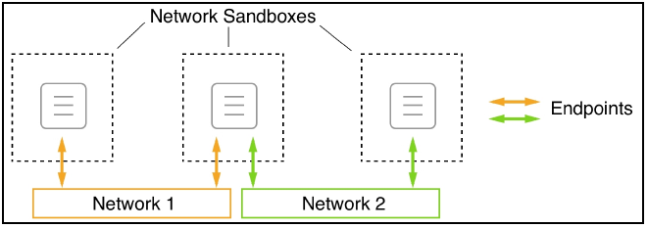
Single-Host Networking
Containers need networks to communicate (duh)
(Docker) Container Network Model (CNM)
Sandbox – isolates container
Endpoint – gateway access to container
Network – endpoint/container comm path
Notes:
39

Slide 40
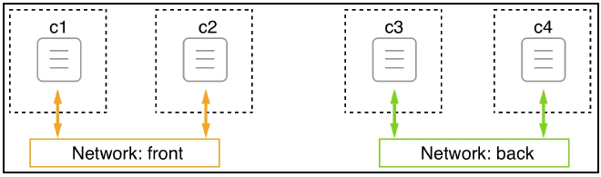
Networking (cont’d)
Obviously, all software defined networks (SDN)
“built in” “security”…
c1 <-> c2 ; c3 <-> c4 ; but 1 & 2 can’t talk to 3 & 4
Notes:
40

Slide 41
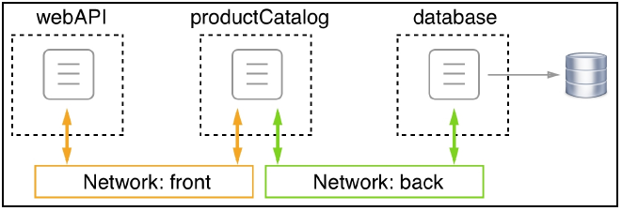
Networking (cont’d)
Setting up for multi-tier, with “security”
Unrelated: note the use of the volume for the DB container
Notes:
41

Slide 42
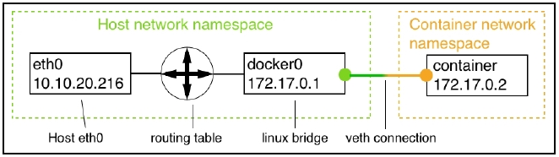
Networking (cont’d)
Bridge Network – based on the Linux bridge (look it up)
Automatically created at Docker 1st run
Default - all containers connect here
$ docker network ls
docker network inspect bridge
IPAM – IP Addy Mgt; like DHCP and router/gateway
Bridge is the router/gateway between host & container comms
Notes:
42

Slide 43
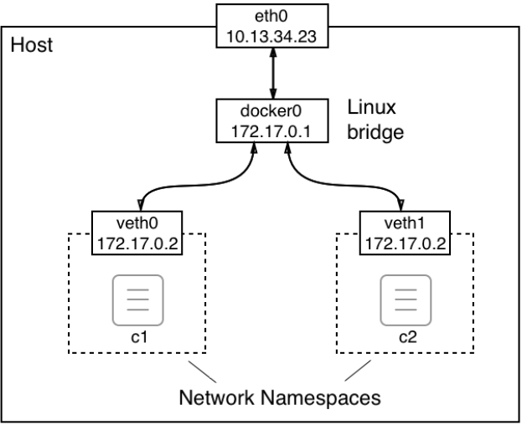
Networking (cont’d)
Default = container egress traffic only!
veth assigned
Can create
multiple (bridge)
networks
Notes:
43

Slide 44
Networking (cont’d)
Let’s play
Create new bridge network
docker network create --driver bridge sample-net
docker network inspect sample-net
Look for “Subnet” – it’s the next range of IPs available
Wanna create a bridge network & assign your own subnet?
docker network create --driver bridge --subnet \
“10.1.0.0/16” test-net
docker network inspect test-net
Notes:
1st network name = sample-net
44

Slide 45
Networking (cont’d)
OK, let’s create and compare containers (diff nets)
docker container run --name c1 -it --network `
test-net alpine:latest /bin/sh
Open another terminal (admin), inspect new container c1
docker container inspect c1
Look for Network Settings, Networks
Back to c1 terminal, check info
# ip addr
ip route
Back to “new” terminal: 2nd container, same network
$ docker container run --name c2 -d --network `
test-net alpine:latest ping 127.0.0.1
Notes:
Ping command keeps container(s) running, rather than exiting immediately
45

Slide 46
Networking (cont’d)
Create add’l containers, connect to sample-net
docker container run --name c3 -d --network `
sample-net alpine:latest ping 127.0.0.1
docker container run --name c4 -d --network `
sample-net alpine:latest ping 127.0.0.1
Inspect for containers (see “Containers”)
docker network inspect bridge
docker network inspect sample-net
docker network inspect test-net
Notes:
Ping command keeps c3 & c4 running, rather than exiting immediately.
46

Slide 47
Networking (cont’d)
Check comms
docker container exec -it c3 /bin/sh
Ping c4 (use IP if you like) – this is test-net check
# ping c4
Success?
Using “c4” proves that Docker DNS works too
Ping c2 (use IP if you like) – this is sample-net check
# ping c2
Fail?
Notes:
47

Slide 48
Networking (cont’d)
HERE WE GO!
Open new terminal, connect a container to BOTH networks
$ docker container run --name c5 -d --network `
test-net alpine:latest ping 127.0.0.1
docker network connect sample-net c5
Exec into c5 and ping, proving multi-net comms
docker container exec -it c5 /bin/sh
Ping c4 (use IP if you like) – this is test-net check
# ping c4
Ping c2 (use IP if you like) – this is sample-net check
# ping c2
Notes:
48

Slide 49
Networking (cont’d)
Clean up
docker container rm -f $(docker container ls -aq)
docker network rm sample-net
docker network rm test-net
docker volume rm -f <volume name>
Notes:
49

Slide 50
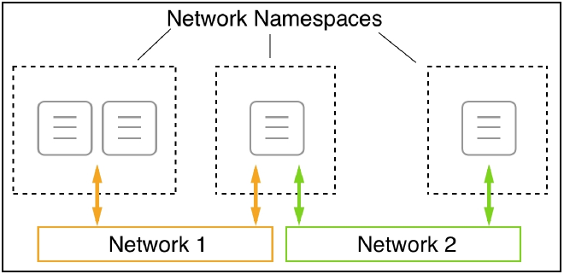
Networking (cont’d)
Running in/adding (container) to existing network namespace
Troubleshooting existing network/container
Kubernetes Pods
Sidecar containers?
Notes:
50

Slide 51
Networking (cont’d)
Create new bridge network
docker network create --driver bridge test-net
Create/attach new container to new network
docker container run --name web -d --network `
test-net nginx:alpine
Create/attach another container to existing container/net namespace
docker container run -it --rm --network `
container:web alpine:latest /bin/sh
View 1st container (nginx) web page from 2nd container
# wget -qO - localhost
Notes:
51

Slide 52
Networking (cont’d)
Cleanup
Exit 2nd container (#)
$ docker container rm --force web
docker network rm test-net
Port Management
Expose a container (accessible to the outside)
Map container port to host port
1) Let Docker decide
docker container run --name web -P -d nginx:alpine
docker container port web
Notes:
52

Slide 53
Networking (cont’d)
Port Mgt (cont’d)
Open web browser
<host IP>:<Docker assigned mapped port>
Nginx web page?
2) Map a specific port (new container)
docker container run --name web2 -p 8080:80 -d `
nginx:alpine
Open web browser
<host IP>:<Docker assigned mapped port>
Nginx web page?
…Clean up…
Notes:
Virtualbox host IP = open virtualbox, double click host (default), type “ifconfig”
Also, from cmd line: docker-machine ls
Also, docker-machine ip default
Also (for hyper-v), ipconfig /all
53

Slide 54
Docker Compose
Docker Compose:
Tool
Use/create YAML file
Declaratively define multi-service/multi-container app
Scaling, self-healing
We will use our previous python app image/container
docker run -p 4000:80 <username>/<repo name>:<tag>
Check web browser (host IP:4000)
Notes:
54

Slide 55
Docker Compose (cont’d)
Let’s build our docker-compose.yml file:
VSCode
version: "3"
services:
web:
# replace username/repo:tag with your name and image details
image: username/repo:tag
deploy:
replicas: 3
resources:
limits:
cpus: "1"
memory: 500M
restart_policy:
condition: on-failure
ports:
- "4000:80"
networks:
- webnet
networks:
webnet:
Notes:
55

Slide 56
Docker Compose (cont’d)
Save in dir with previous image/container stuff
Stop other containers (JIC)
docker container ls
docker container stop <container name>
Run new docker-compose file (from saved dir)
For this example we’re using Docker Swarm(Kit)! *
docker swarm init
docker stack deploy -c `
<docker-compose-filename2.yml> `
<name your stack>
* May need to specify IP, as stated in (potential) error message
Notes:
56

Slide 57
Docker Compose (cont’d)
List all (new) containers (be patient, 3 container replicas)
docker container ls
Try removing a container
docker container rm -f <container name>
docker container ls
Self-healing?
Open web browser, check for load balancing (hostname?)
curl works too
Clean up
docker stack rm <stack name>
docker swarm leave --force
Notes:
57

Slide 58
Resources
http://Labs.play-with-docker.com
Https://romanirani.com/tutorial-gettin-started-with-kubernetes-on-your-windows-laptop-with-minikube-3269b54a226
http://John-cd.com/cheatsheets/containers/minikube_install_on_windows
https://docs.docker.com/engine/docker-overview/
Notes:
58

